Slide 1



Deep learning for real-time robust facial expression analysis
Khryashchev Vladimir
Head of Artificial Intelligence Center

Slide 2
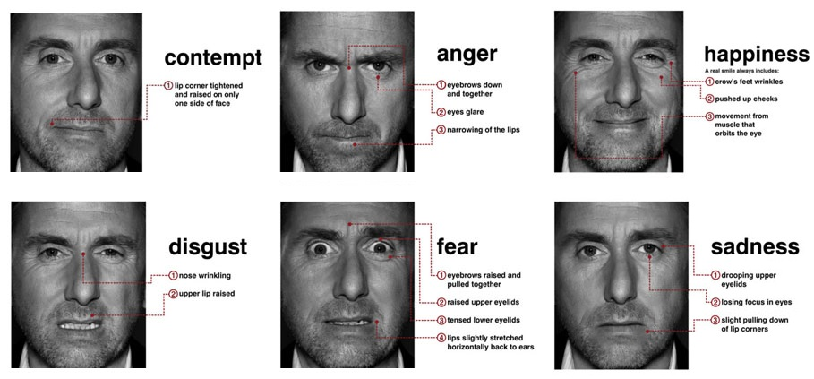
Motivation
Development of effective real-time algorithm of facial expression recognition based on deep convolutional neural network
Ekman P. and Friesen W.V. 1977. Manual for the Facial Action Coding System, Consulting Psychologists Press.

Slide 3
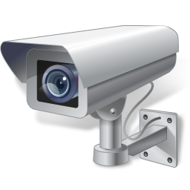



Application Areas
Videoanalysis
Security
Medicine
Data analytics in Retail
Computer-Human Interaction

Slide 4
Algorithm Requirement
Support of Real-Time video streams
Recognize spontaneous expressions for different viewing angles
Robust against lighting conditions, face resolutions, etc.

Slide 5
Image Processing Steps
Capture face images from the database or video stream
Preprocessing (interference reduction, filtering, sharpening, etc.)
Generation of set of features
Classification

Slide 6
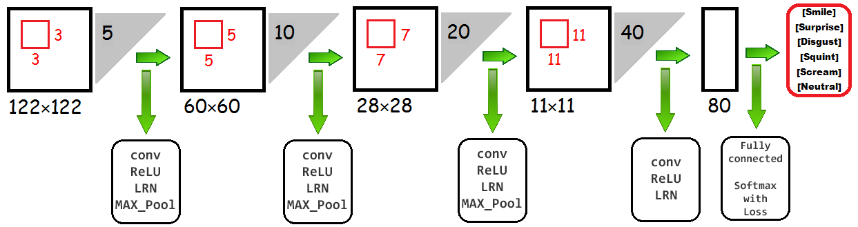
Simple convolutional neural network
Numerical optimization algorithm: stochastic gradient descent (SGD)
Z. Niu, M. Zhou, L. Wang, X. Gao, G. Hua, “Ordinal Regression with Multiple Output CNN for Age Estimation”, 2016 IEEE Conference on Computer Vision and Pattern Recognition, 2016, pp. 4920–4928.

Slide 7
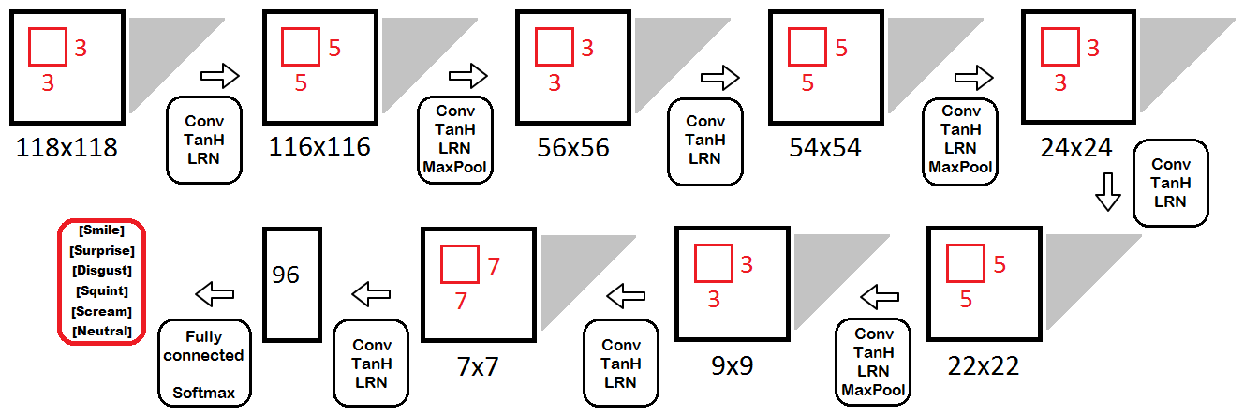
Complicated convolutional neural network
Added more convolutional layers
Changed sizes of convolutional layers
Added more activation and normalization layers

Slide 8
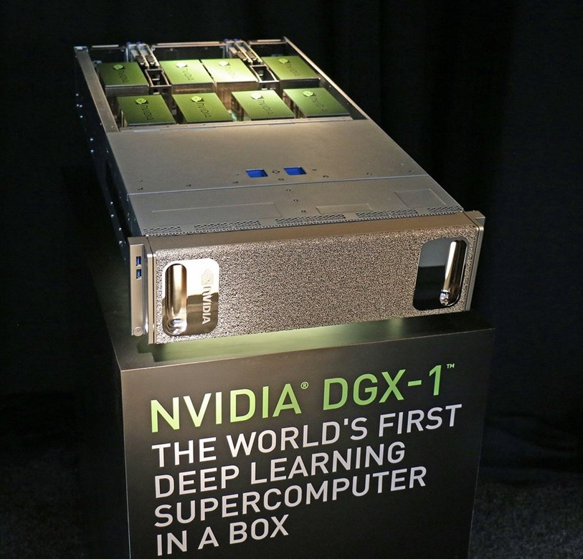
Training and testing
Training: ~45 min
Testing: ~8-10 min, means classification of 42 000 images.
Artificial Intelligence Center of P.G Demidov Yaroslavl State University

Slide 9
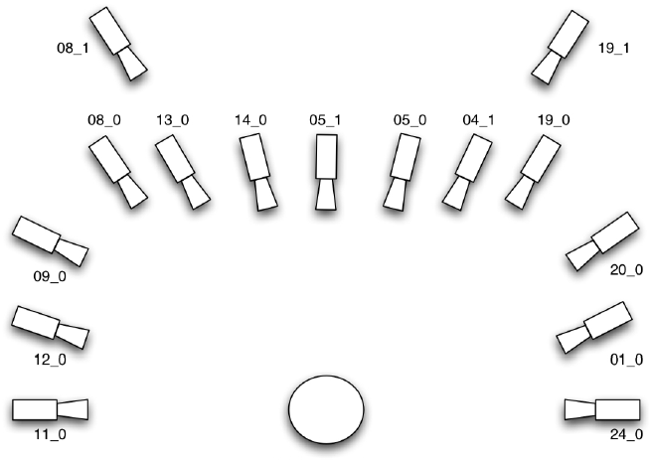
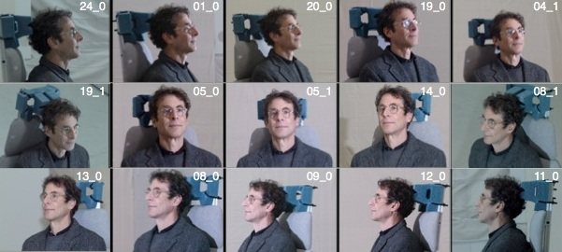
Multi-PIE Face Database
~750000 color images
337 different subjects
different angles (less than 90°) with various scene illumination
http://www.cs.cmu.edu/afs/cs/project/PIE/MultiPie/Multi-Pie/Home.html

Slide 10
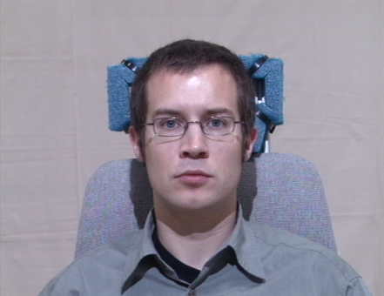
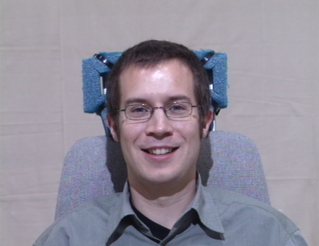
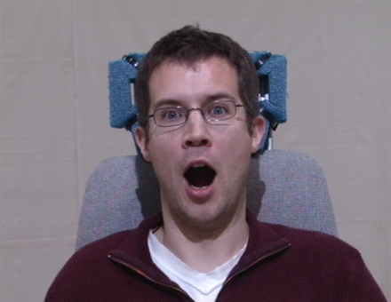
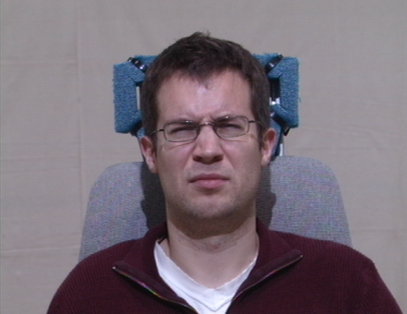
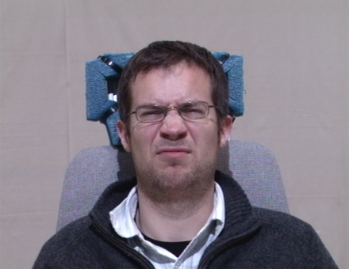
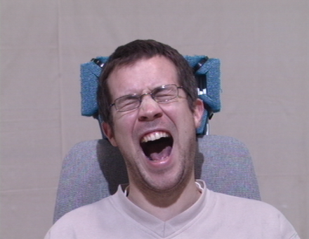
Classes of facial expression
a) Neutral
b) Smile
c) Surprised
d) Squint
e) Disguist
f) Scream
http://www.cs.cmu.edu/afs/cs/project/PIE/MultiPie/Multi-Pie/Home.html

Slide 11
Dataset Preparation
210000 randomly selected and mirrorred images
(35000 images for each type of emotions)
Angle of view: [-45, 45]
Train and test samples: 80/20

Slide 12
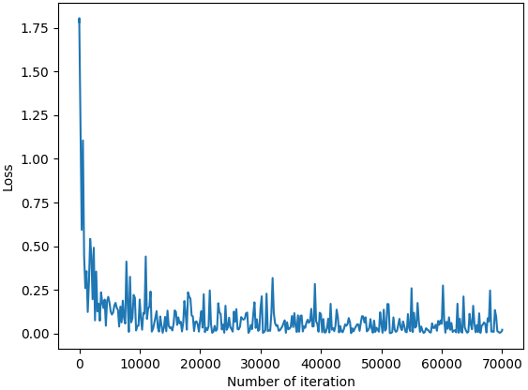
Learning process
Neural Network Model | Accuracy
Simple | 92,29%
Complicated | 94,48%

Slide 13
Results (Confusion Matrix)
Classes |  | Real class
 |  | Smile | Surprise | Disgust | Squint | Scream | Neutral
Predicted class | Smile | 6471/ 6526 | 48/ 37 | 68/ 53 | 8/ 6 | 4/ 1 | 136/ 145
 | Surprise | 87/ 140 | 6715/ 6767 | 3/ 2 | 1/ 0 | 47/ 16 | 30/ 8
 | Disgust | 102/ 72 | 28/ 2 | 6006/ 6322 | 556/ 334 | 34/ 33 | 61/ 43
 | Squint | 143/ 148 | 20/ 2 | 749/ 541 | 6112/ 6479 | 12/ 9 | 184/ 166
 | Scream | 53/ 21 | 98/ 156 | 48/ 18 | 22/ 7 | 6903/ 6940 | 26/ 1
 | Neutral | 144/ 93 | 91/ 36 | 126/ 64 | 301/ 174 | 0/ 1 | 6563/ 6637

Slide 14
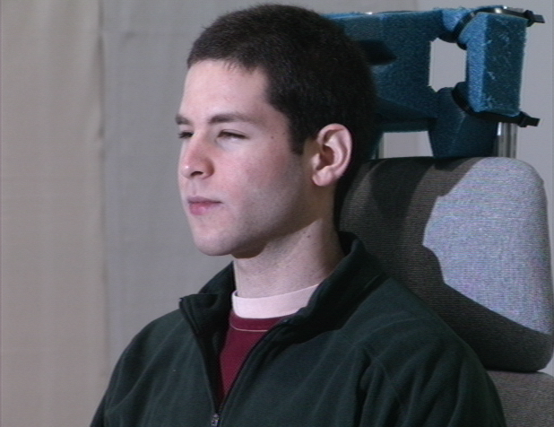
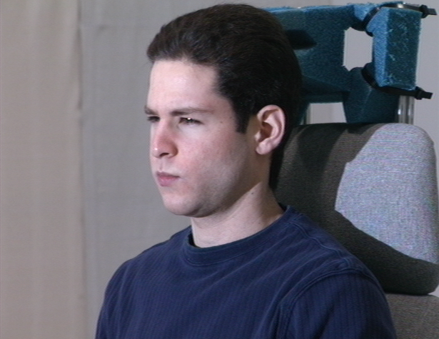
Similar classes
a) Squint
b) Disguist

Slide 15
Results
Error analysis |  | Metrics
 |  | Precision (P) | Recall (R) | F-score (F)
Classes | Smile | 0,96/ 0,96 | 0,82/ 0,93 | 0,94/ 0,95
 | Surprise | 0,98/ 0,98 | 0,96/ 0,97 | 0,97/ 0,97
 | Disgust | 0,89/ 0,93 | 0,86 0,9 | 0,87/ 0,92
 | Squint | 0,85/ 0,88 | 0,87/ 0,93 | 0,86/ 0,9
 | Scream | 0,97/ 0,97 | 0,99/ 0,99 | 0,98/ 0,98
 | Neutral | 0,91/ 0,95 | 0,92/ 0,95 | 0,92/ 0,95

Slide 16
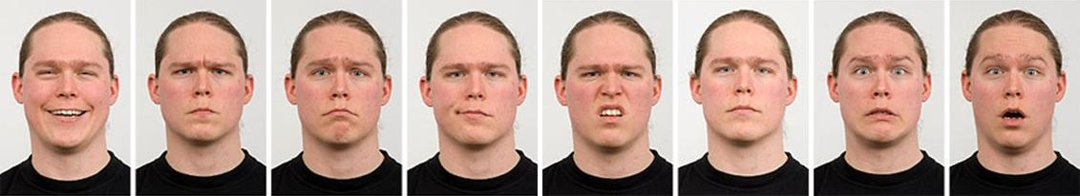
Future Work
Testing for other databases of face images
Radboud Faces Database:
more than 8000 colour images of 67 different subjects
5 angles of view : 0°, 45°, 90°, 135°, 180°
8 facial expressions (neutral, sadness, contempt, surprise, happiness, fear, anger, and disgust)
http://www.socsci.ru.nl:8180/RaFD2/RaFD?p=main

Slide 17

Future Work
Testing for other databases of face images
FER2013 Database:
black-and-white images of 48x48
3 sets: training (28709 images), validation (3589 images), testing (3589 images)
7 facial expressions (anger, disgust, fear, happiness, sadness, surprise, neutral)
https://www.kaggle.com/c/challenges-in-representation-learning-facial-expression-recognition-challenge/data

Slide 18

Future Work
Testing for other databases of face images
AFEW:
contain video materials from Hollywood movies.
each video is labelled on time slices
contain people of different ages, focuses and resolutions of faces
labelling includes information about names and ages of actors, ages for their role, facial expressions and cues
6 facial expressions (anger, disgust, fear, happiness, surprise, neutral)

Slide 19
Conclusions
The use of complicated structure CNN allow us to increase an accuracy from 92.29% to 94.48%.
The value of F-score is greater than 0.9 for each class.
The confusion-matrix shows that for facial expression analysis the most difficult types of emotions are “Disgust” and “Squint”.
The designing algorithm can be used in real-time applications in embedded systems, such as NVIDIA Jetson.

Slide 20
Deep learning for real-time robust facial expression analysis
Khryashchev Vladimir
Ivanovsky Leonid
Priorov Andrey

